Slide 1
ARDUINO BASED RADAR SYSTEM
BY:
PRASAD LOMTE : PC 29
ADITI KUMARI :PC 40
DHRUV KUSHALKAR: PC 42

Slide 2
CONTENTS
INTRODUCTION
RADAR SYSTEM
SOFTWARE USED
BLOCK DIAGRAM
OUTPUTS
CONCLUSION

Slide 3
INTRODUCTION
In this project, we have designed Arduino RADAR Model using Ultrasonic Sensor for Detection and Servo motor . RADAR is an object detection system that uses radio waves to identify the range, altitude, direction, and speed of the objects.
In this Arduino RADAR project ,we aims to achieve a radar system prototype based on an Arduino board, capable of detecting objects.

Slide 4
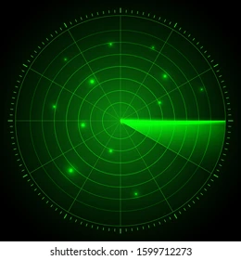
RADAR SYSTEM
Radar, electromagnetic sensor used for detecting, locating, tracking, and recognizing objects of various kinds at considerable distances. It operates by transmitting electromagnetic energy toward objects, commonly referred to as targets, and observing the echoes returned from them. The targets may be aircraft, ships, spacecraft automotive vehicles, and astronomical bodies, or even birds, insects, and rain.

Slide 5
EXAMPLES OF RADAR SYSTEM
Airport surveillance radar
Doppler weather radar
Airborne combat radar
Ballistic missile defense and satellite-surveillance radars
Ground-probing radar

Slide 6
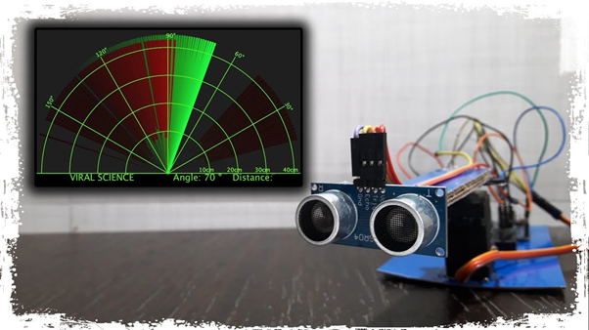
COMPONENTS AND SOFTWARE USED:
ULTRA SONIC SENSOR HCSR04
SERVO MOTOR
ARDUNIO UNO
MATLAB
TINKERCAD

Slide 7
WORKING PRINCIPLE OF COMPONENTS USED
ULTRASONIC SENSOR
An ultrasonic sensor is an electronic device that measures the distance of a target object by emitting ultrasonic sound waves, and converts the reflected sound into an electrical signal. Ultrasonic waves travel faster than the speed of audible sound (i.e. the sound that humans can hear).
SERVO MOTOR
A servomotor is a rotary actuator or linear actuator that allows for precise control of angular or linear position, velocity and acceleration.^{[1]} It consists of a suitable motor coupled to a sensor for position feedback. It also requires a relatively sophisticated controller, often a dedicated module designed specifically for use with servomotors.

Slide 8
BLOCK DIAGRAM
ULTRA SOUND DECTOR
ARDUNIO UNO
SIGNAL PROCESSING MATLAB
TRIGGER
OBSTACLE
ECHO
SERVO MOTOR

Slide 9
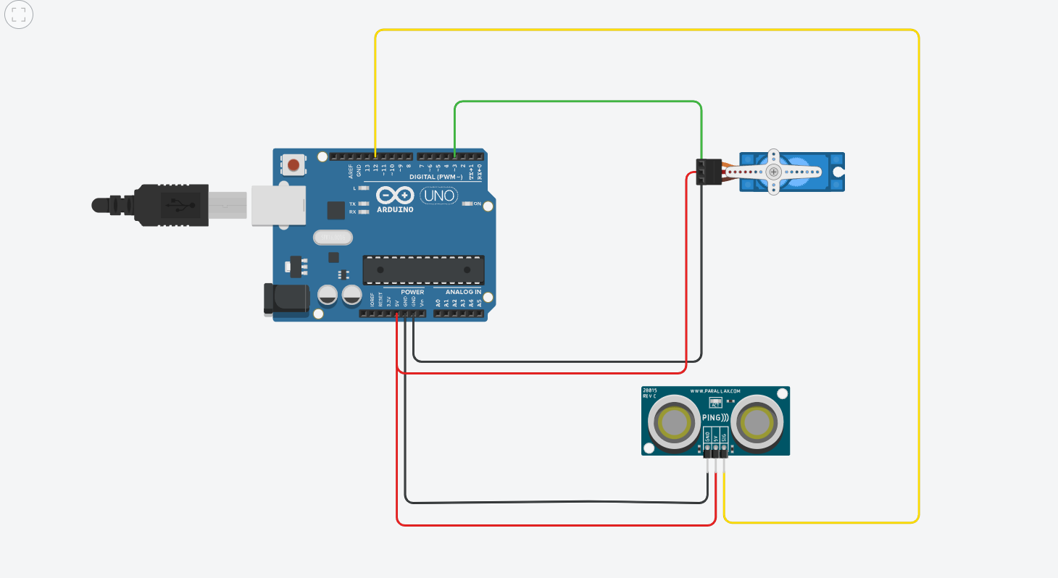
CIRCUIT DIAGRAM

Slide 10
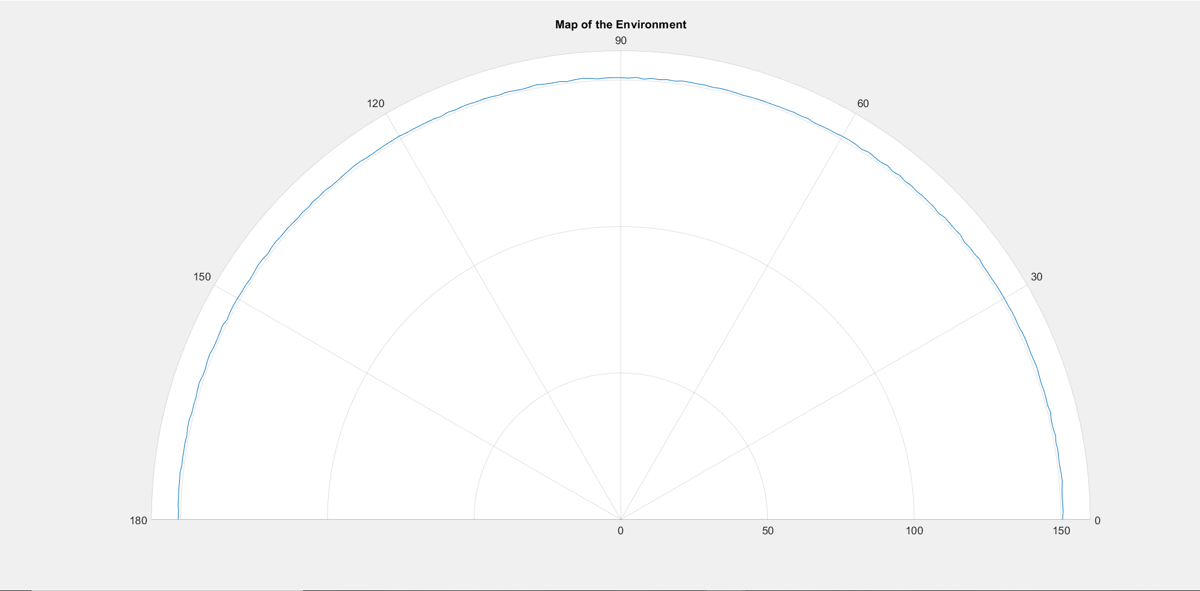
OUTPUT: WHEN NO OBJECT IS DETECTED

Slide 11
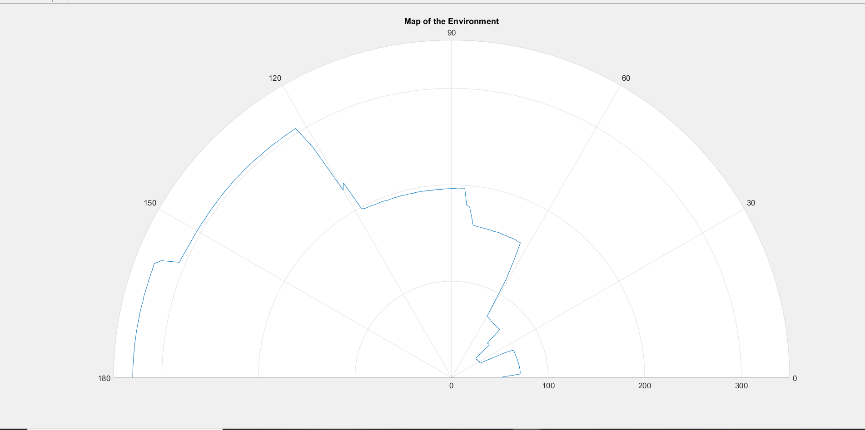
OUTPUT:WHEN OBJECT IS DETECTED

Slide 12
ADVANTAGES
Easy to design and low price. The ultrasonic sensors are available at the market with very cheap price..
It has high frequency, high sensitivity, therefore, it can easily detect the external or deep objects
This radar sensor is not affected by dust, rain, snow, and many more.
It is not affected by color or transparency. Basically, the Ultrasonic Sensors transmit the sound off of the object, hence the color and transparency have no effect on the radar reading.

Slide 13
DISADVANTAGES
The Arduino Radar Sensor conduct sound to continue the work. So, it is not working in a vacuum as there is no air for the sound to travel through.
Another limitation is the detection range. This depends on which Ultrasonic sensor have used to make the Arduino Radar Sensor.
. A very soft fabric can absorb more sound waves. Therefore, it is hard to detect objects which are covered with soft fabric.

Slide 14
THANK YOU

